Slide 1

Chapter 0: Water Security

Slide 2
Chapter 0: Water Security
Johnson & Clarke (2019 in submission): What is Water Security? Journal of Hydrology

Slide 3

Chapter 0: Water Security
SUPPLY
Land Use
Climate
Behavior

Slide 4
Chapter 1: R Tools for Hydrologic Spatial Data Science

Slide 5



AOI

Slide 6
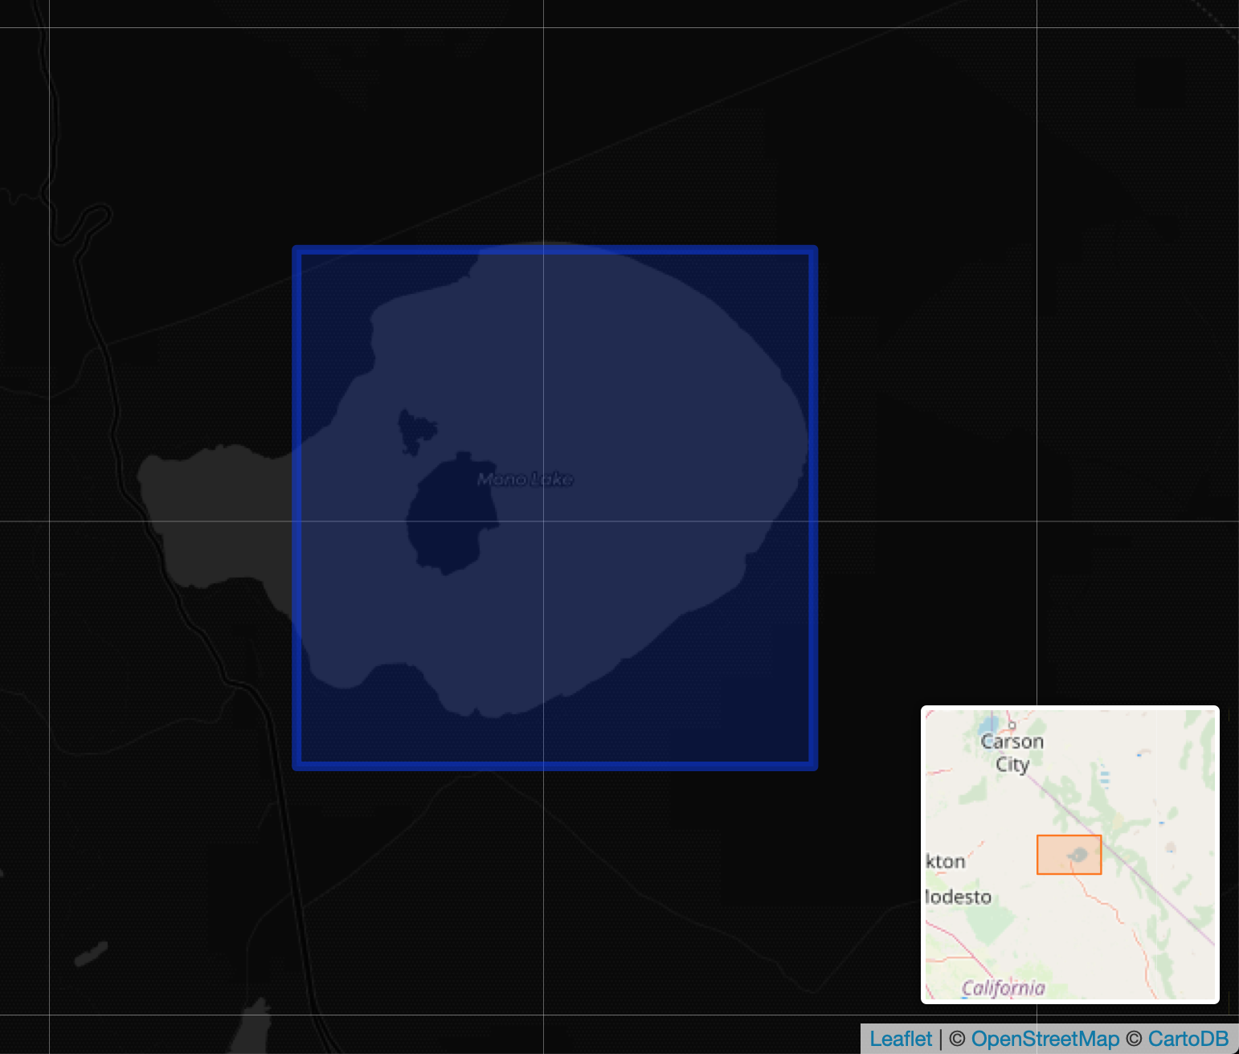
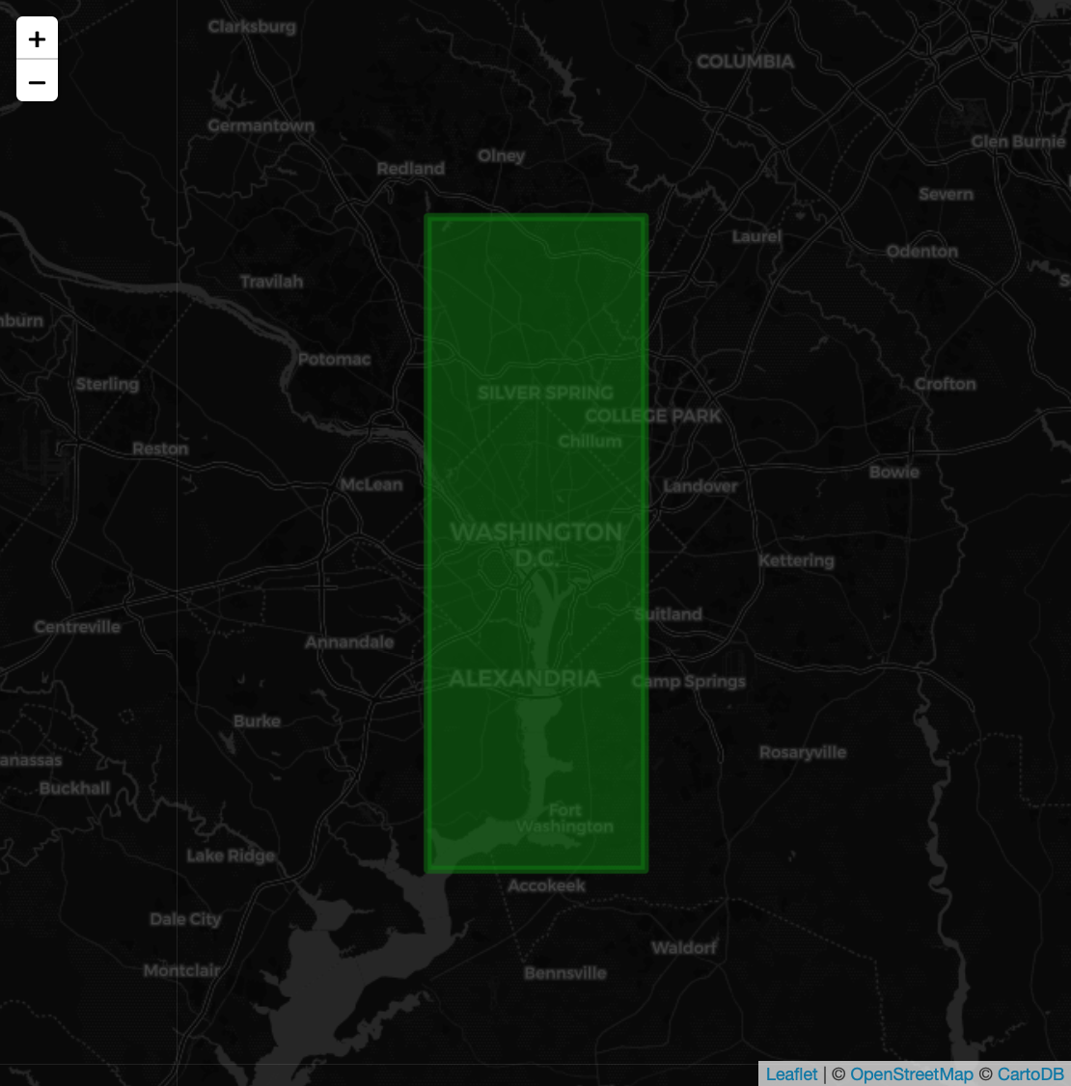
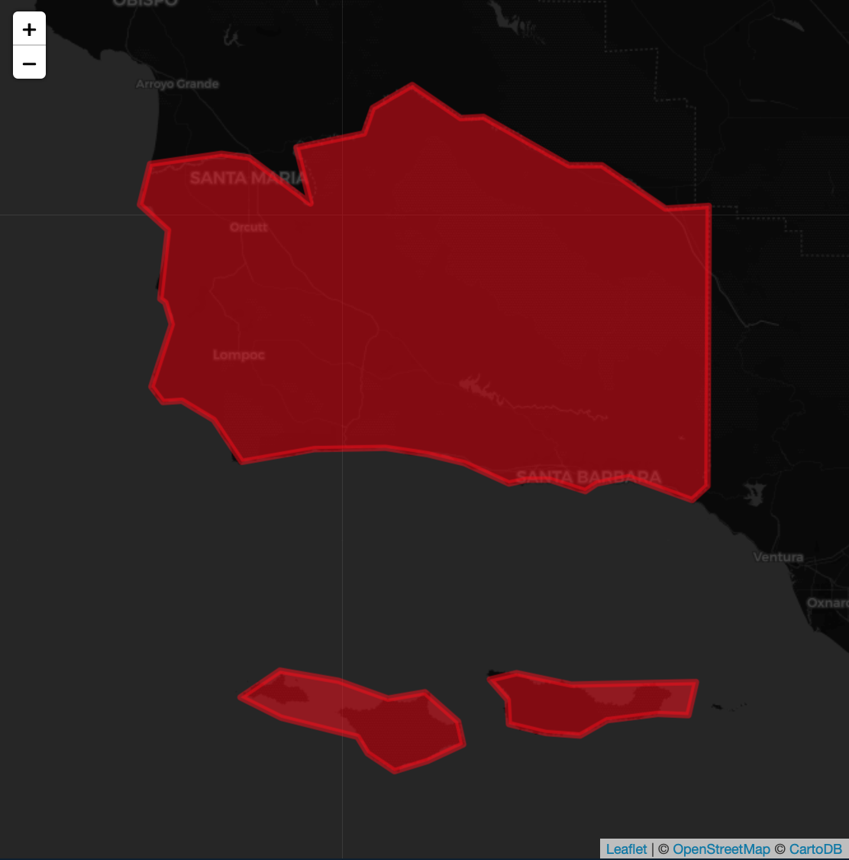
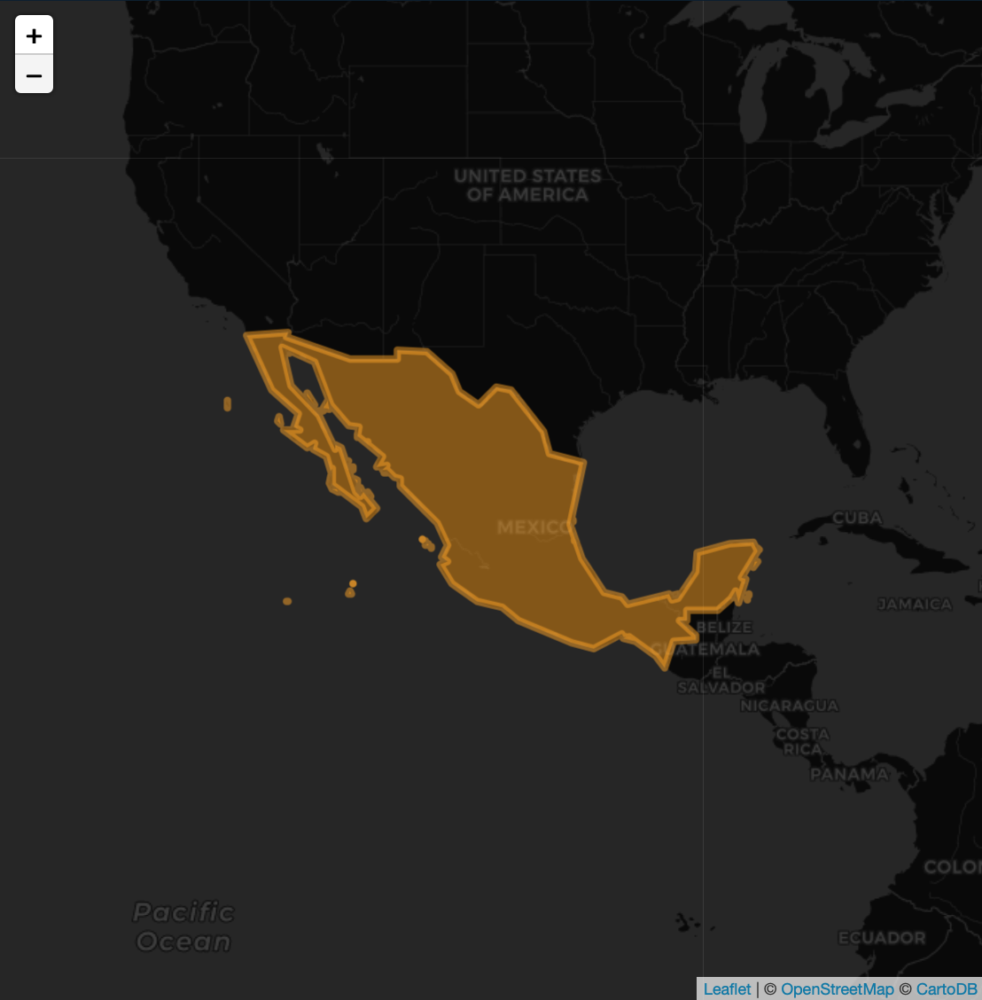
AOI

Slide 7
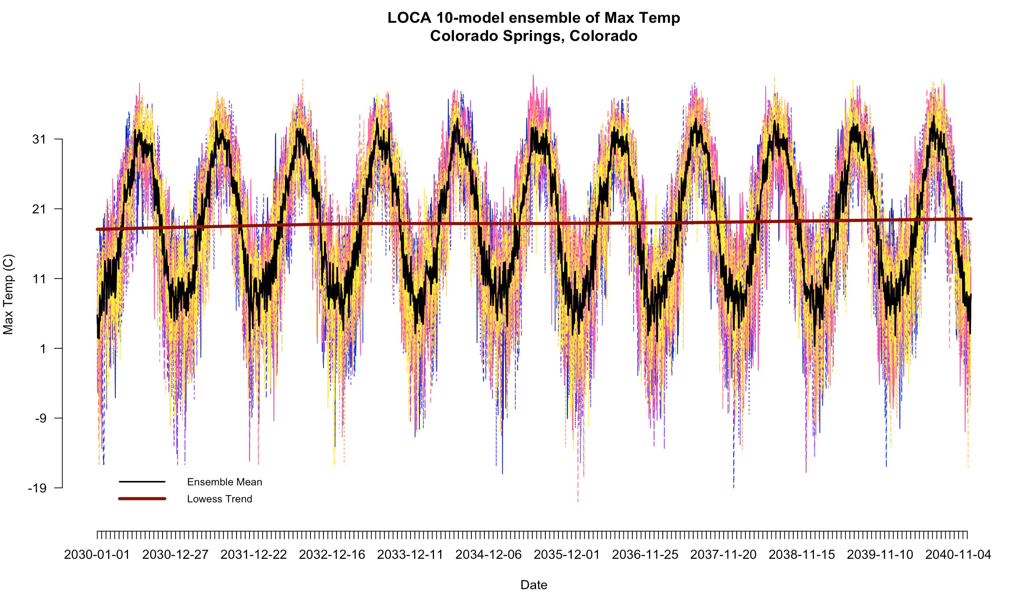
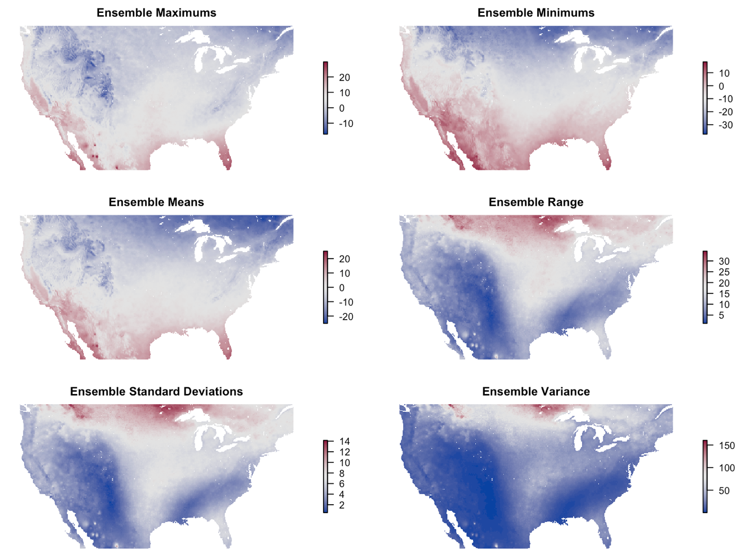
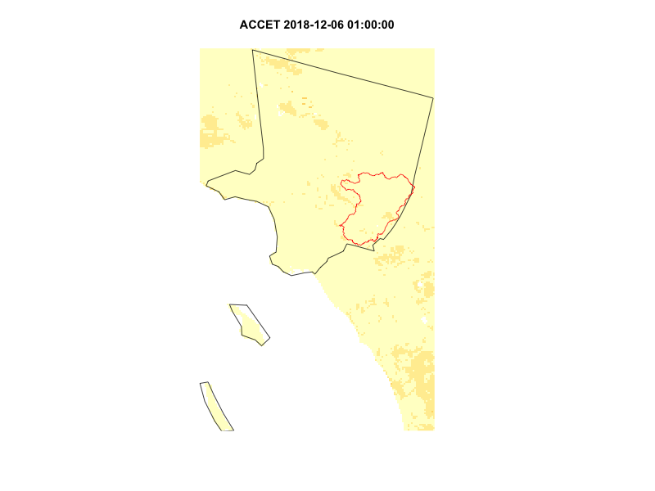
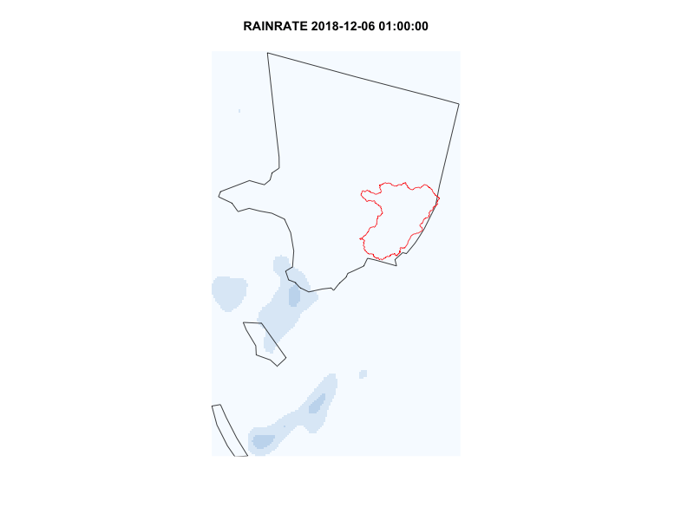
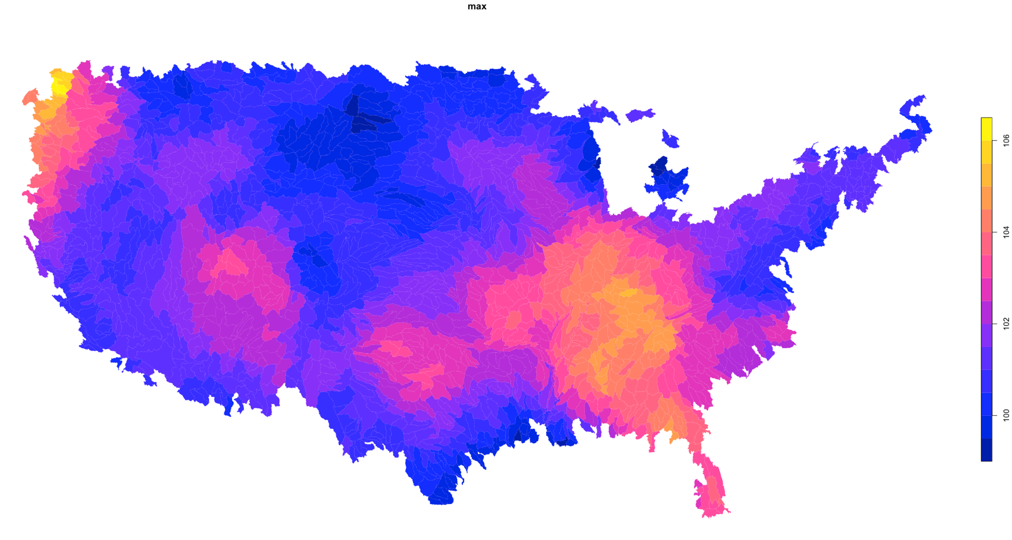

Slide 8
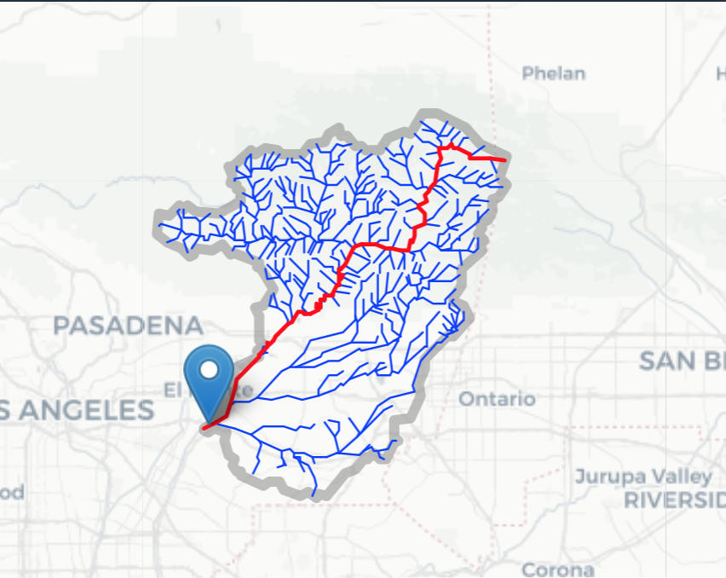
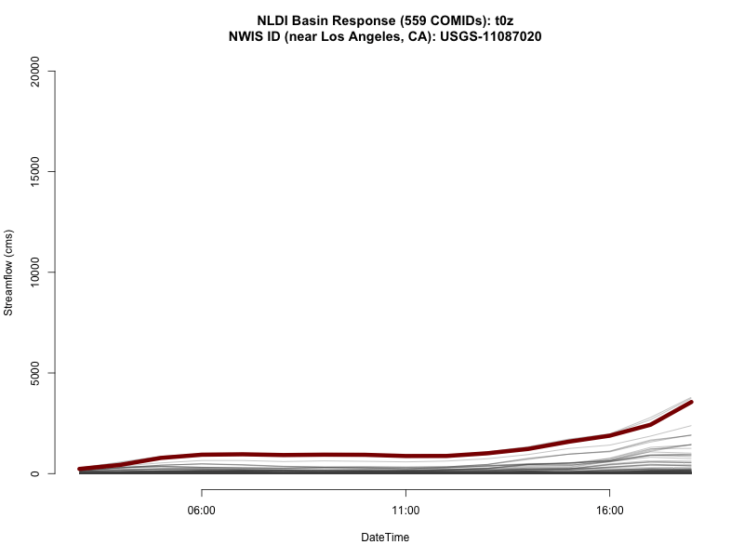
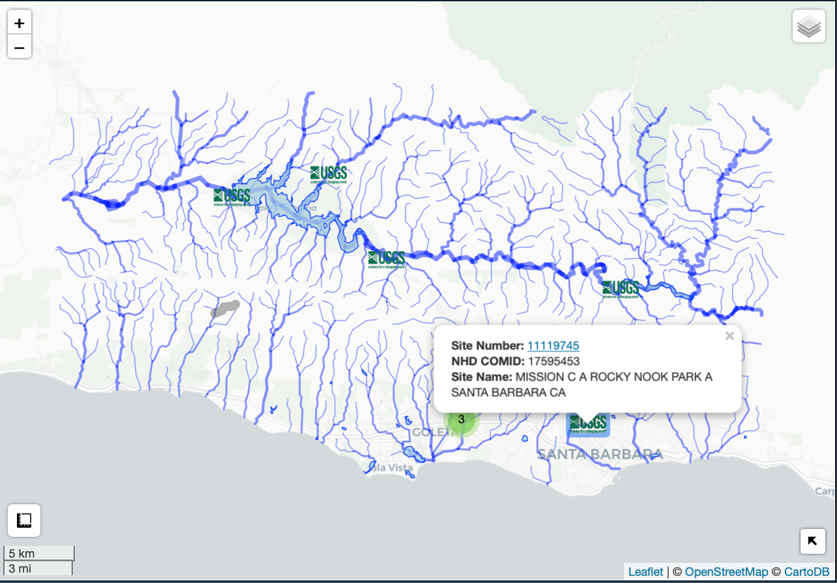
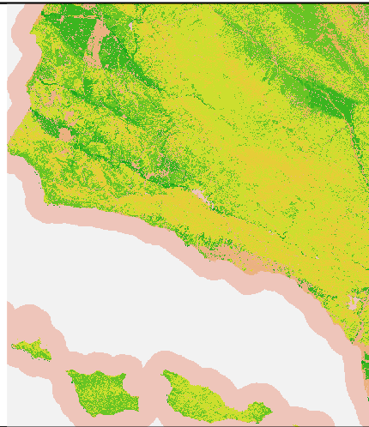

Slide 9
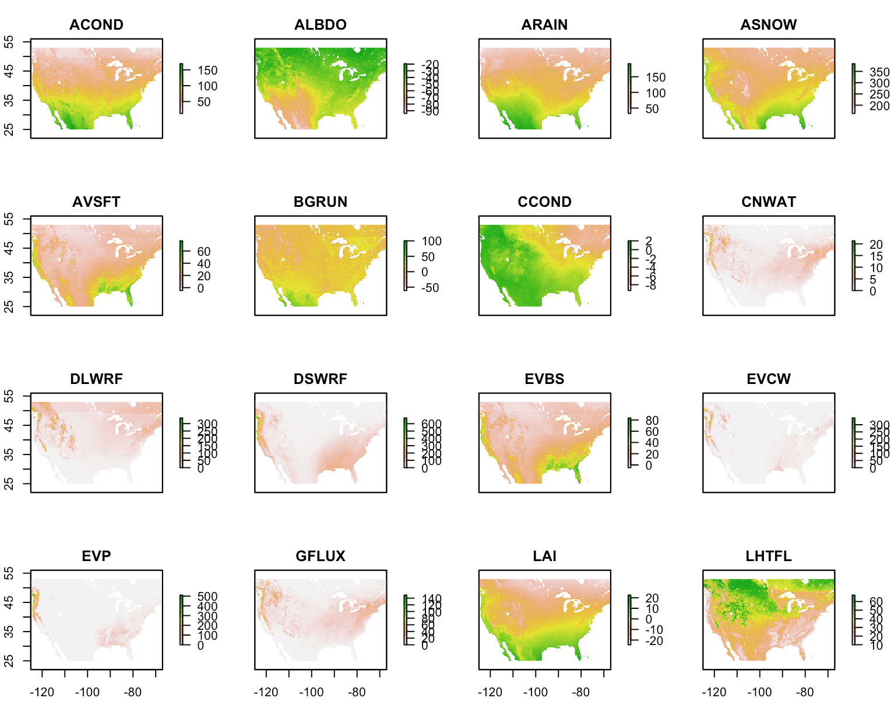

Slide 10
Chapter 2: Land Use Change

Slide 11
SLEUTH 2100

Slide 12
Sea level Rise land use implications
Changes to LULC
NAP Report

Slide 13
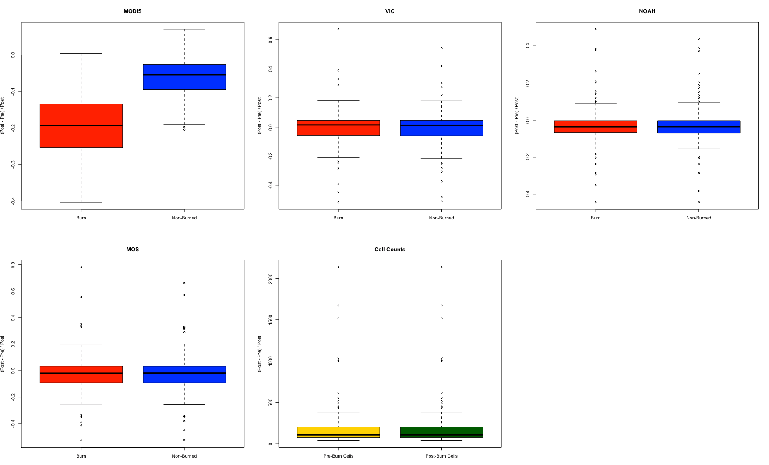
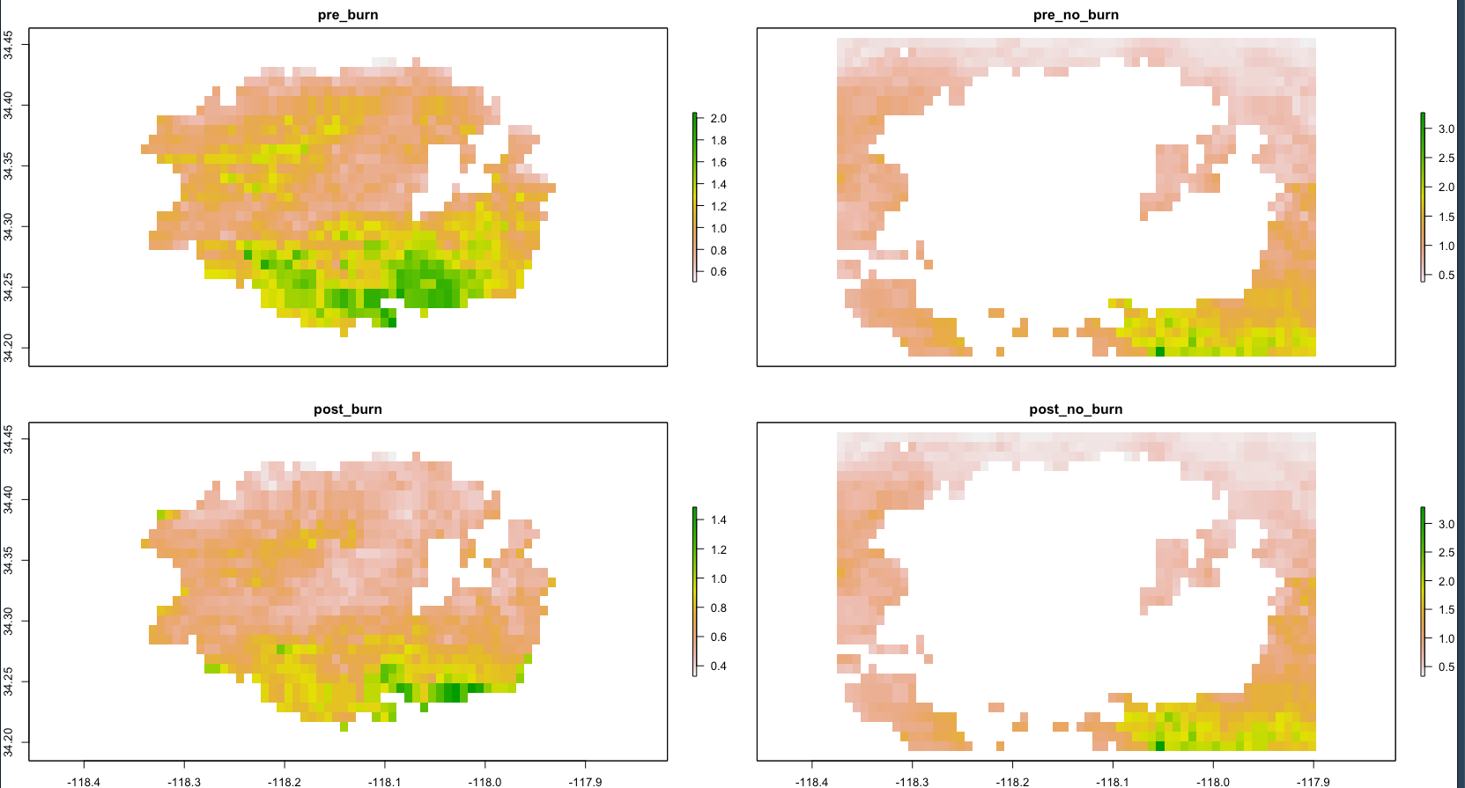
Disturbance
Johnson and Shukla

Slide 14
Chapter 3: Climate

Slide 15
Water Supply = Q – GW
Q is run-off
GW is ground water

Slide 16
Q = PPT – AET
Q is run-off
PPT is precipitation
AET is actual evapotranspiration

Slide 17
AET = PET x Kc
AET is actual evapotranspiration
PET is potential evapotranspiration (climate driven E)
Kc is multiplier (vegetation T)

Slide 18
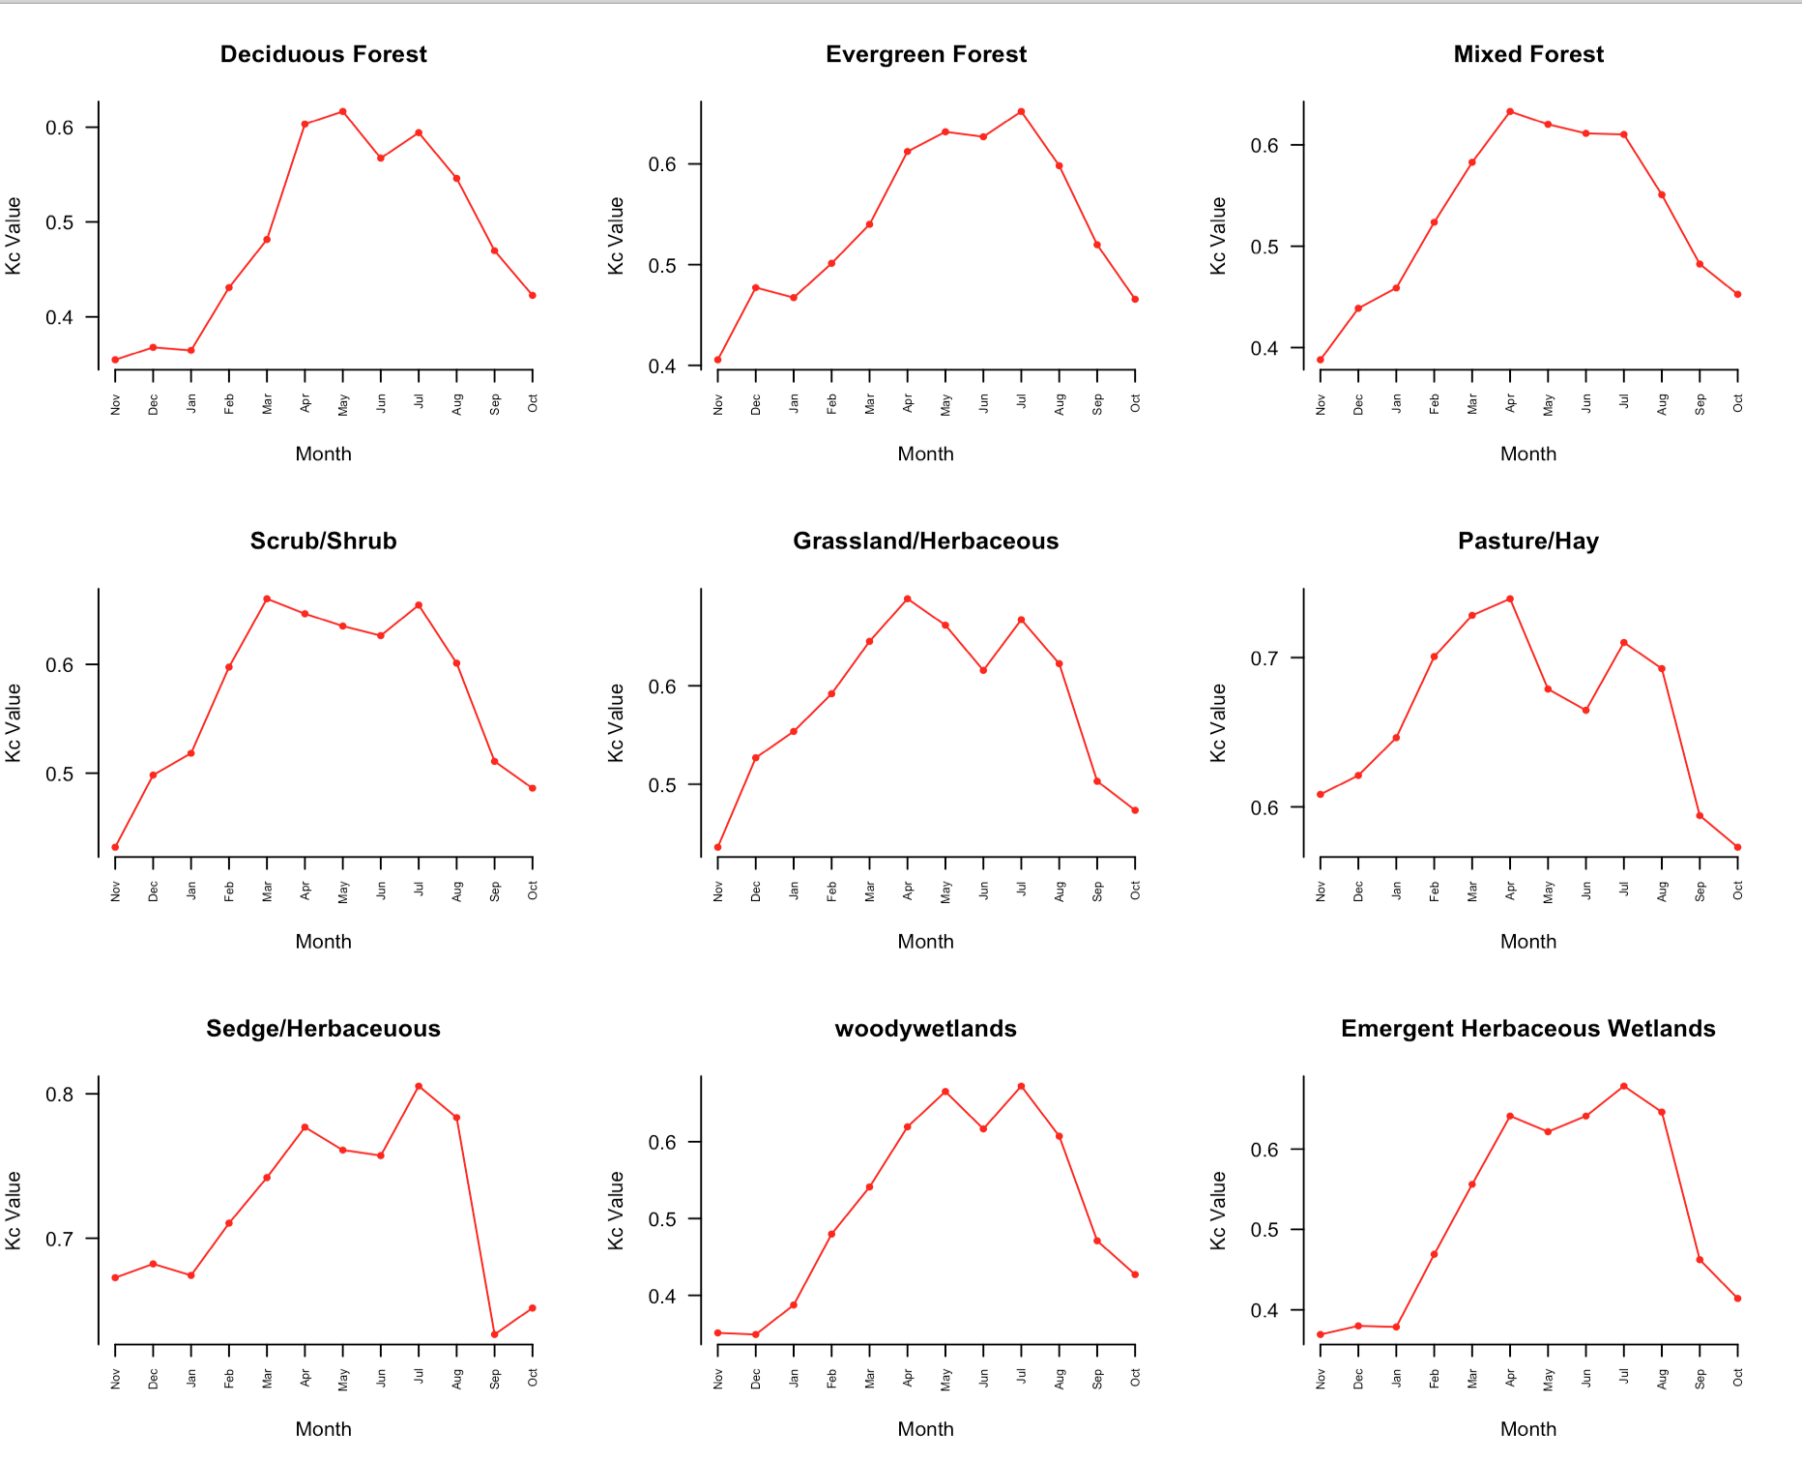
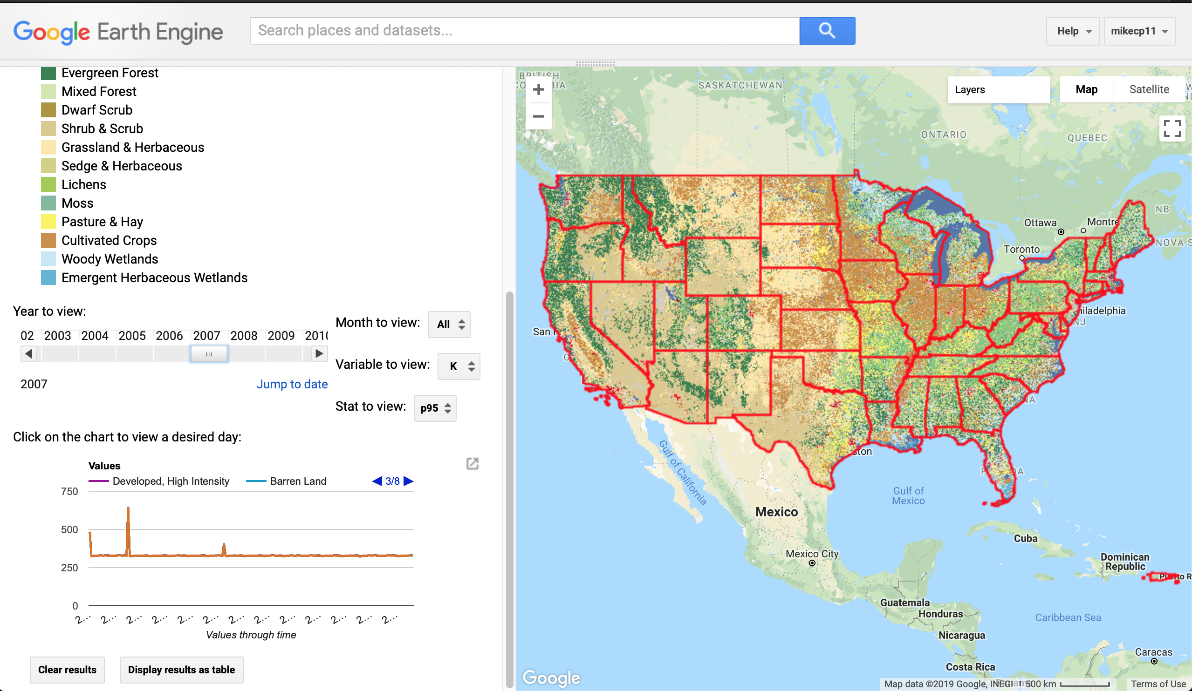
Chapter 3: Climate Pressures (Kc)
Kc = (MODIS-AET / MODIS-PET) %>% group_by(LC) %>% summarise_by(95%)
By 8-day period 2001 - Current

Slide 19
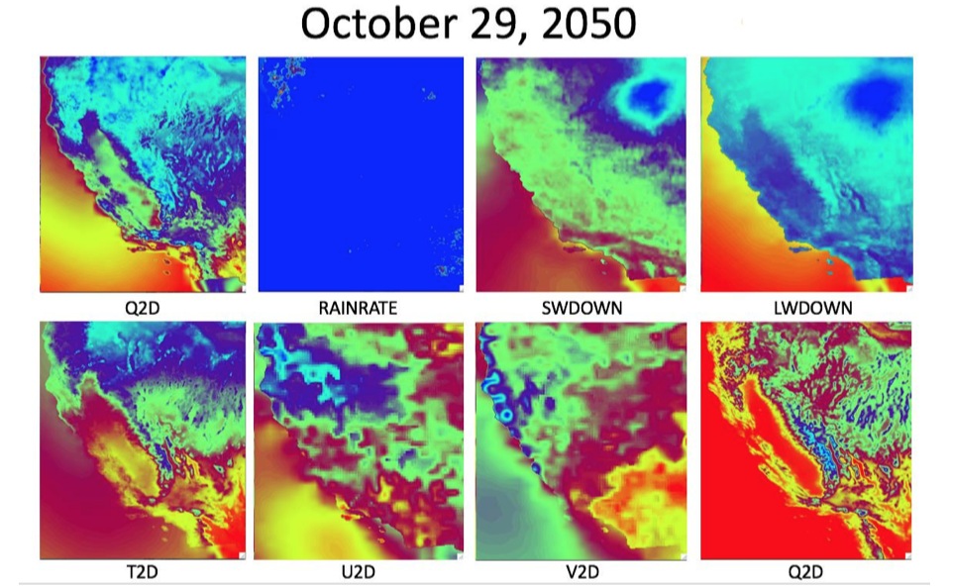
Accessing CA water supply to climate variability
Under a static land cover (NLCD 2011) how will California Q, ET, and SWE change with a variable climate:
1. Two Scenario, 10 member ensemble products downscaled to 1km hourly slices…

Slide 20
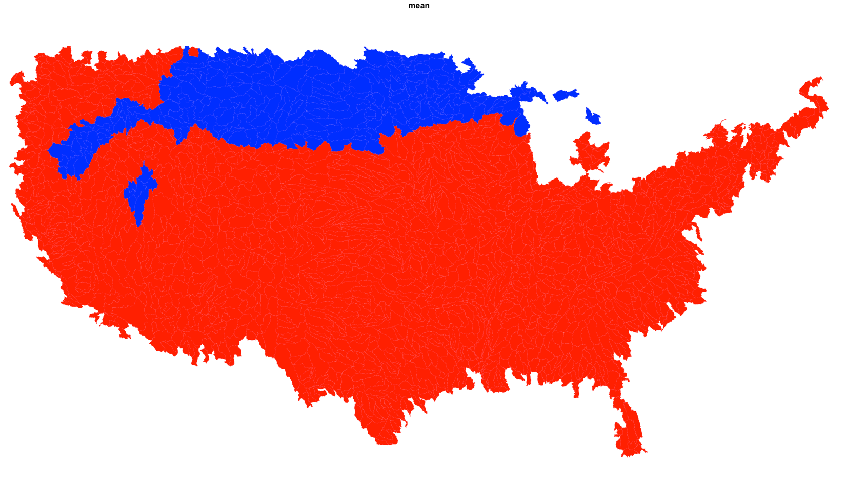
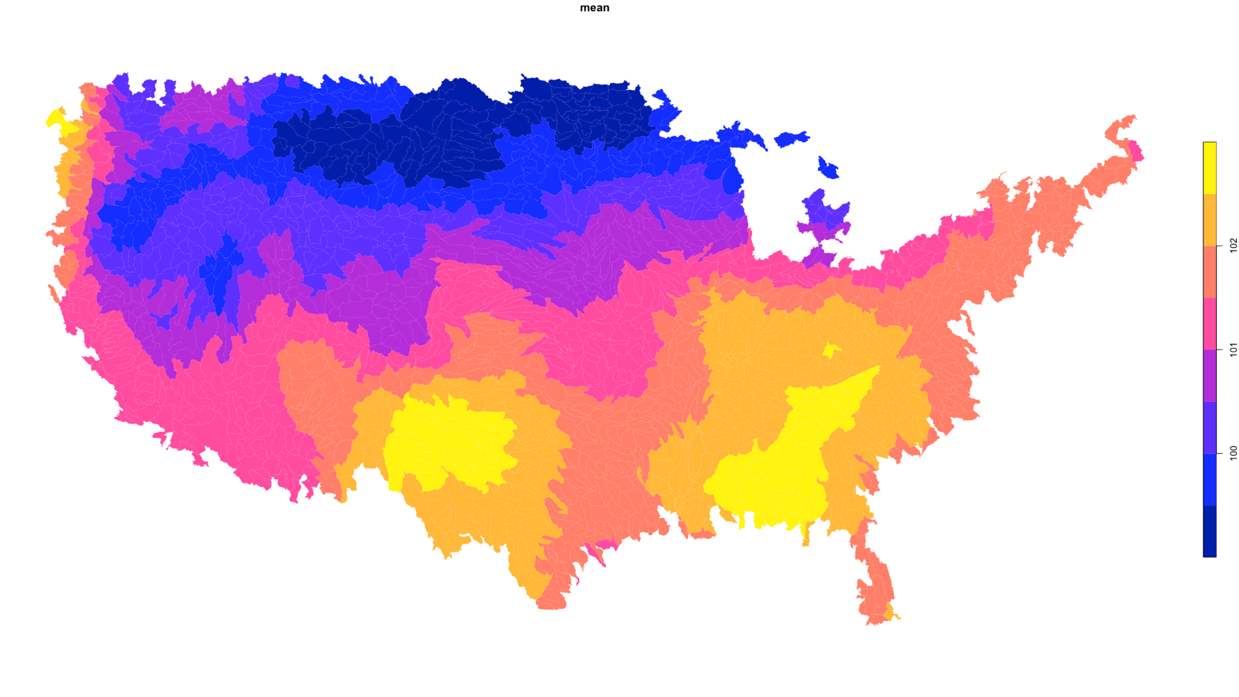
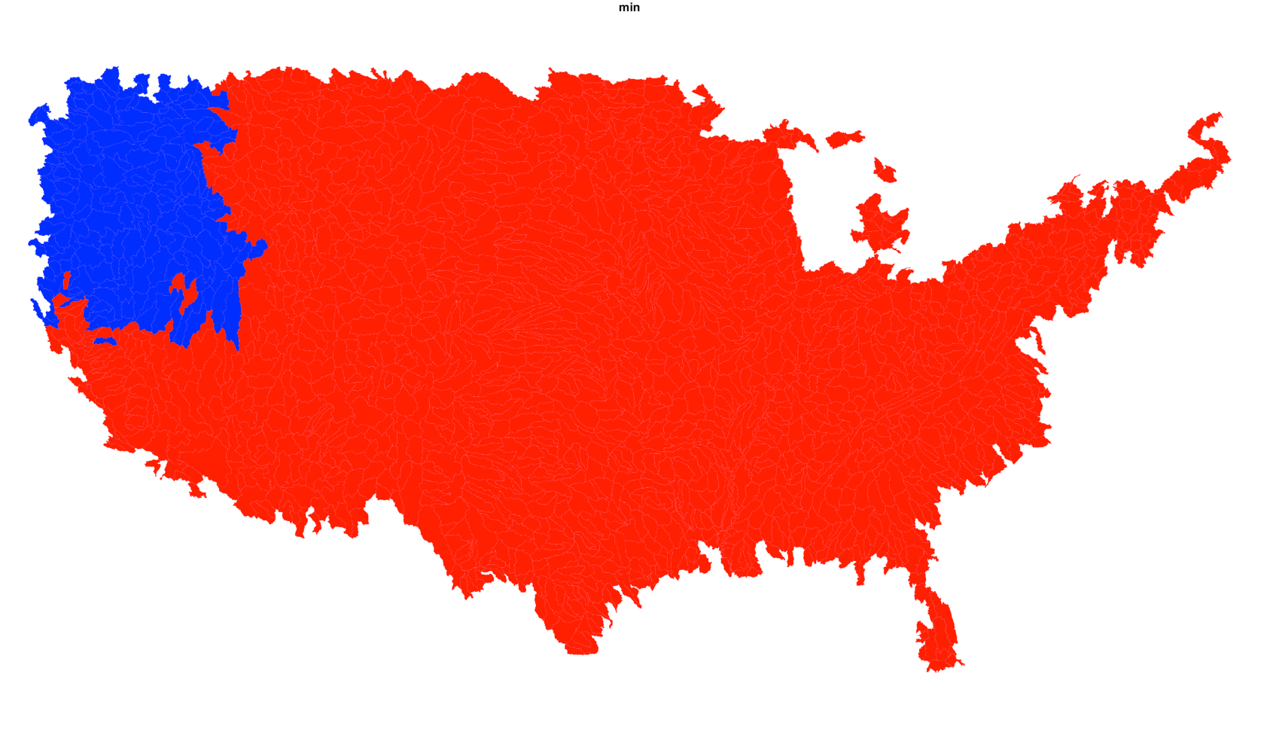
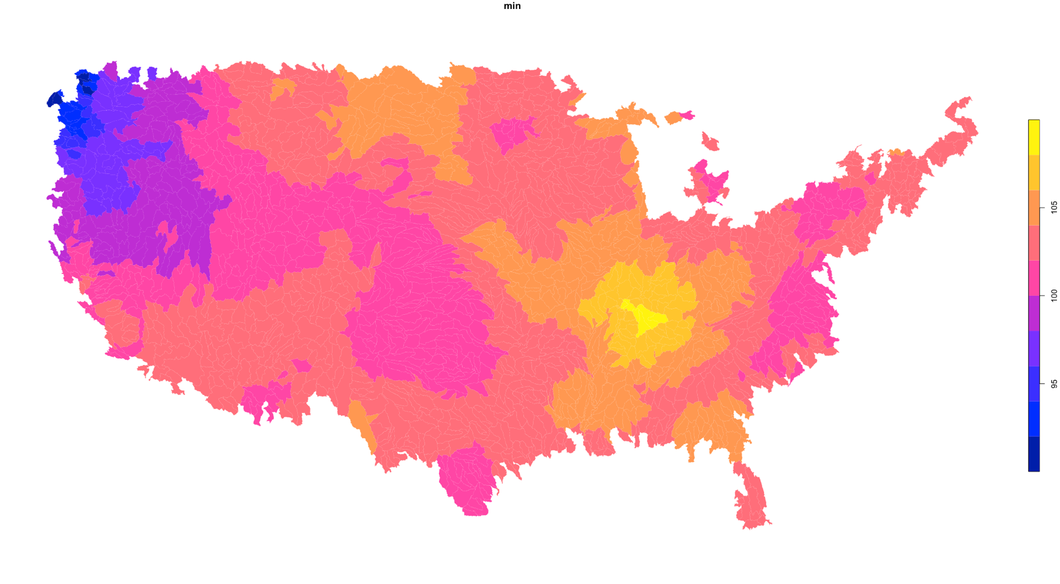
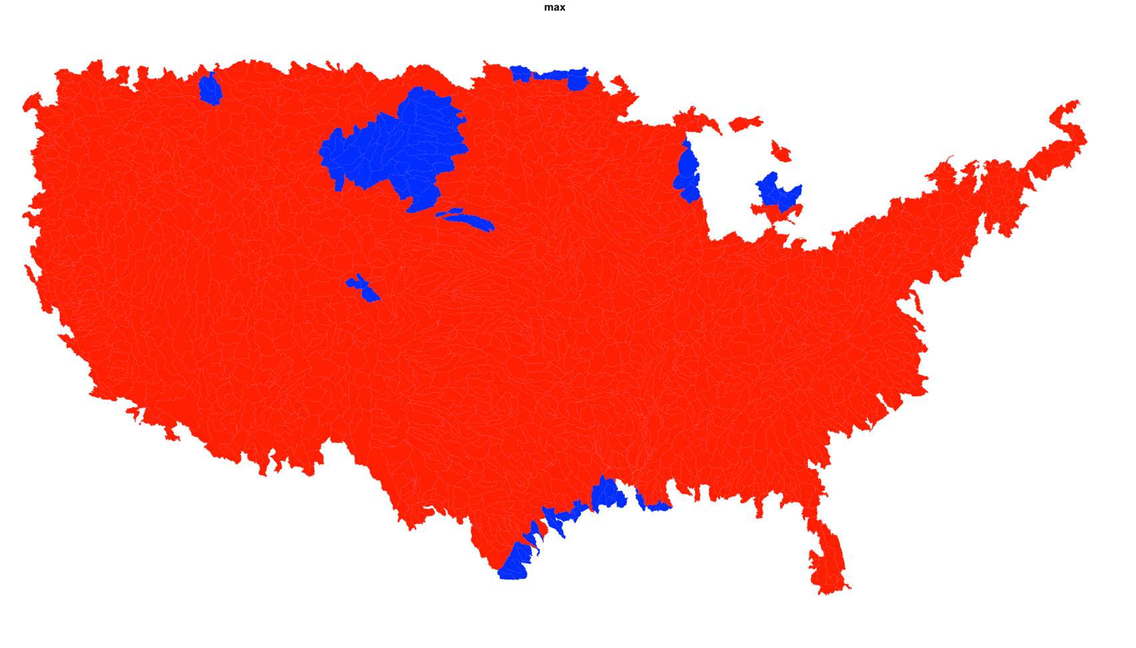
Chapter 3: Climate Pressures (PET)
1st round of evaluation:
RCP 8.5; Model CNRM-CM5
MACA Downscaling (4km)
Monthly PET Aggregated to HUC8
2016 - 2075
For each basin (one model run)
compute the annual min, mean,
and max PET
2. Divide the mean(2045:2075) /
mean(2016:2044)
Available:
RCP 8.5 and RCP 4.5
10 model ensemble
1. dwrad
2. rhum
3. shum
4. tmax
5. tmin
6. totrad
7. vp
8. wind
Johnson & Clarke

Slide 21
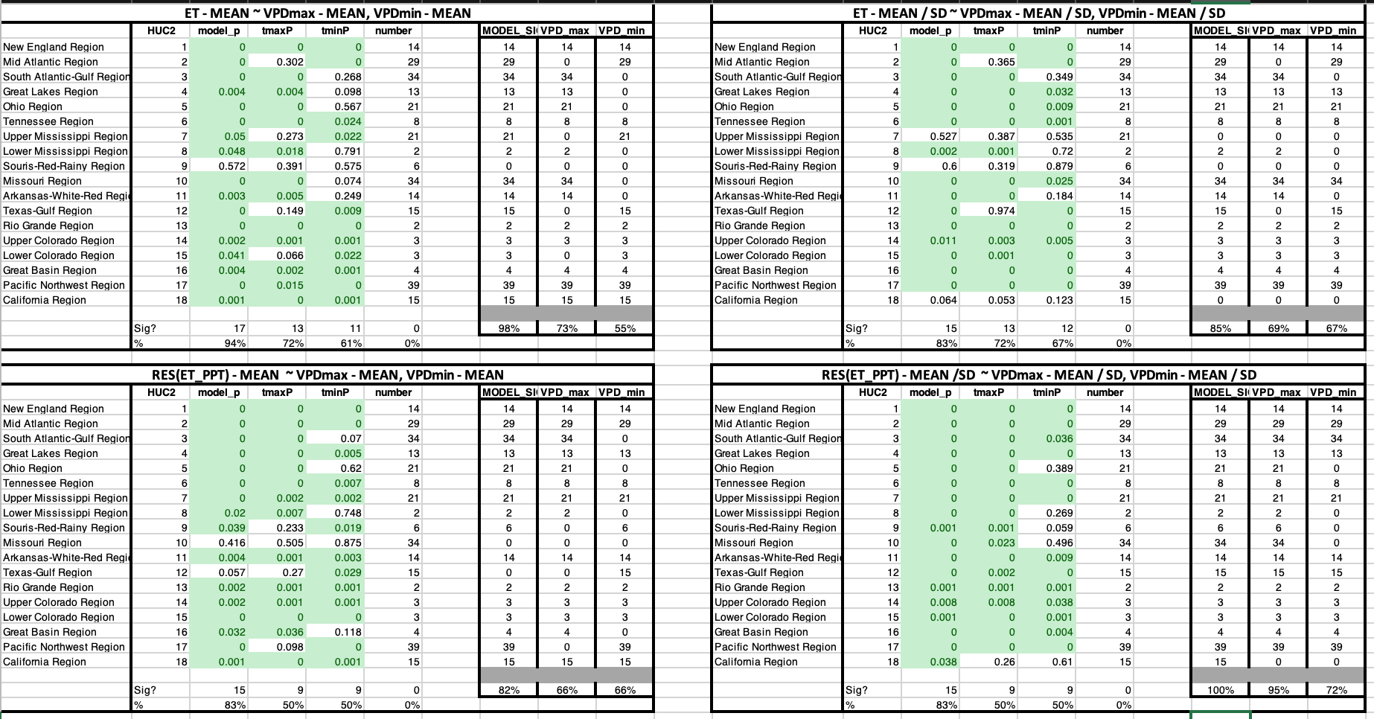
Impacts of Temperature on AET (measured by Q – PPT)

Slide 22
Chapter 4: California Hydrologic Simulations -
WRF-Hydro / NWM

Slide 23
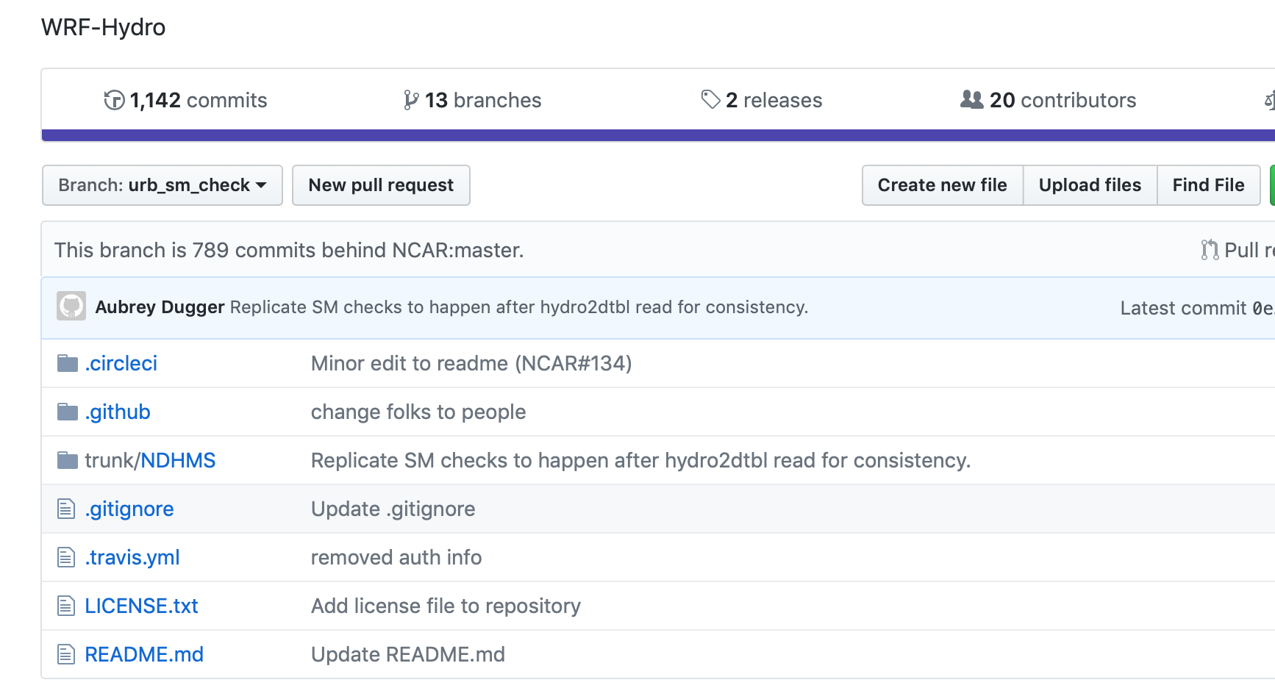
Improve infiltration scheme to transition from single urban slab to heterogenous account for impervious surface percentage

Slide 24
Improving channel geometry representations
23 year reanalysis NWM run
Use streamflow and velocity records to define cross-sectional areas
Derive top-widths and stage from NWM trapezoidal geometries
Use hydraulic power laws to compute at-station Hydraulic Geometries

Slide 25
Accessing CA water supply to land use variability
Under a static climate (1988-2018) how will California Q, ET, and SWE change with a variable land cover:
1. Two Scenario upscaled SLEUTH products to 1 km …

Slide 26
Chapter 5: California Hydrologic Simulations

Slide 27
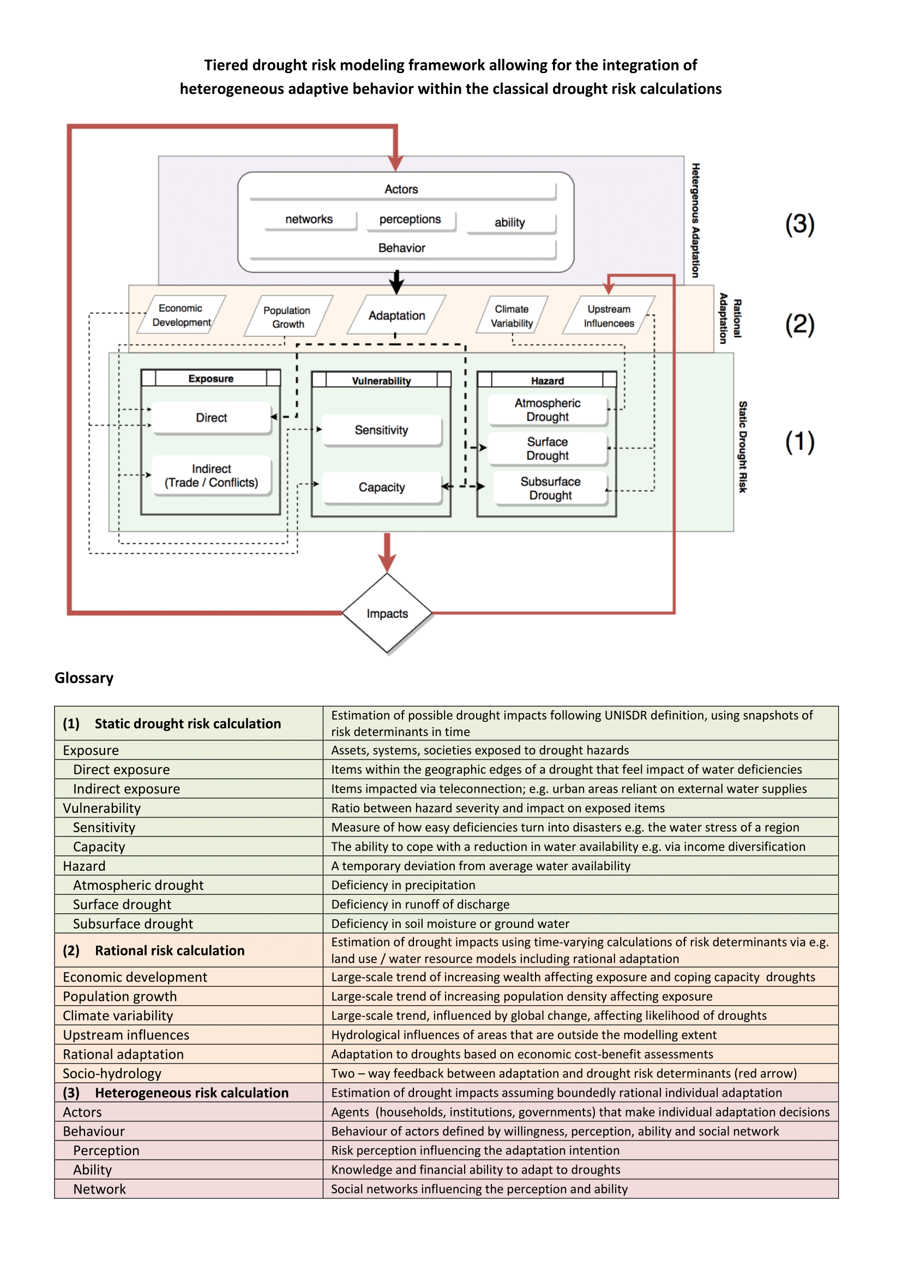
Chapter 6: Human Intervention
Wens, Johnson, Zagaria, Veldkemp (2019: Accepted): Integrating human behavior dynamics into drought risk assessment - A socio-hydrologic, agent-based approach. Wires WATER

Slide 28
ABM
Chapter 5: California Hydrologic Simulations

Slide 29
Chapter 6: Applications

Slide 30
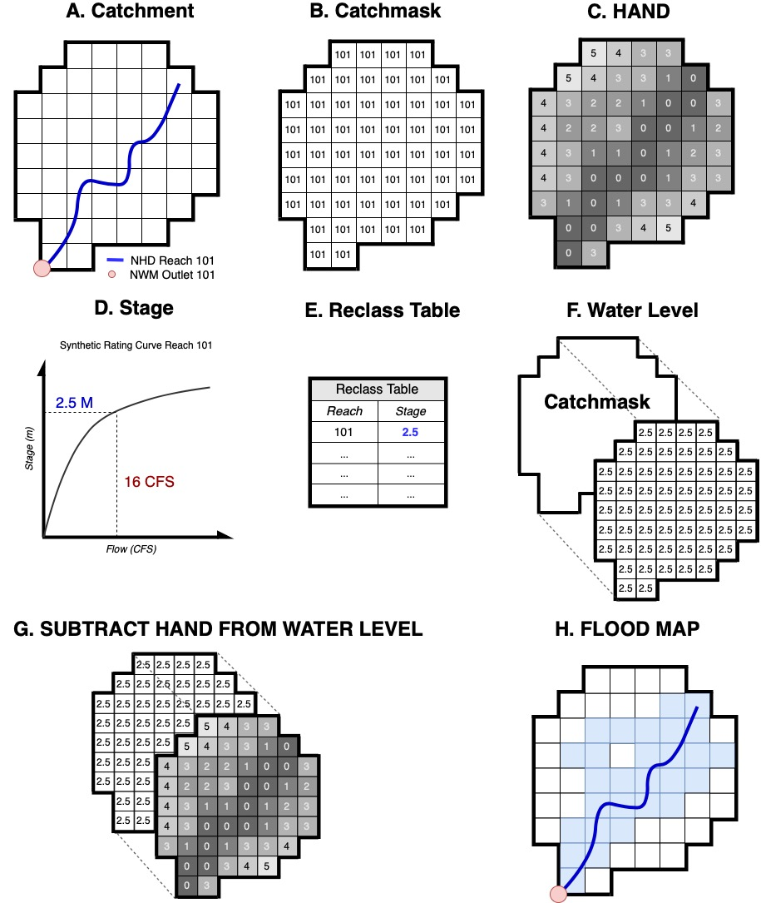
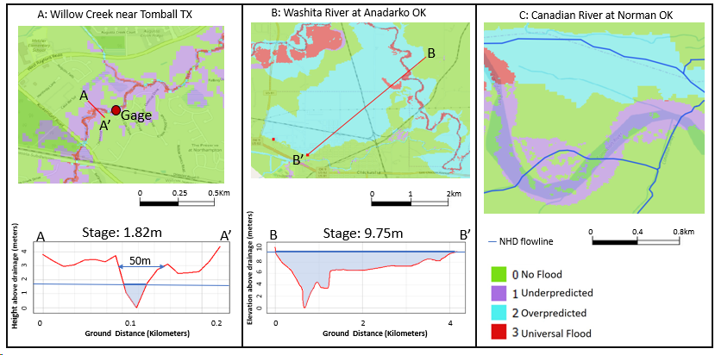
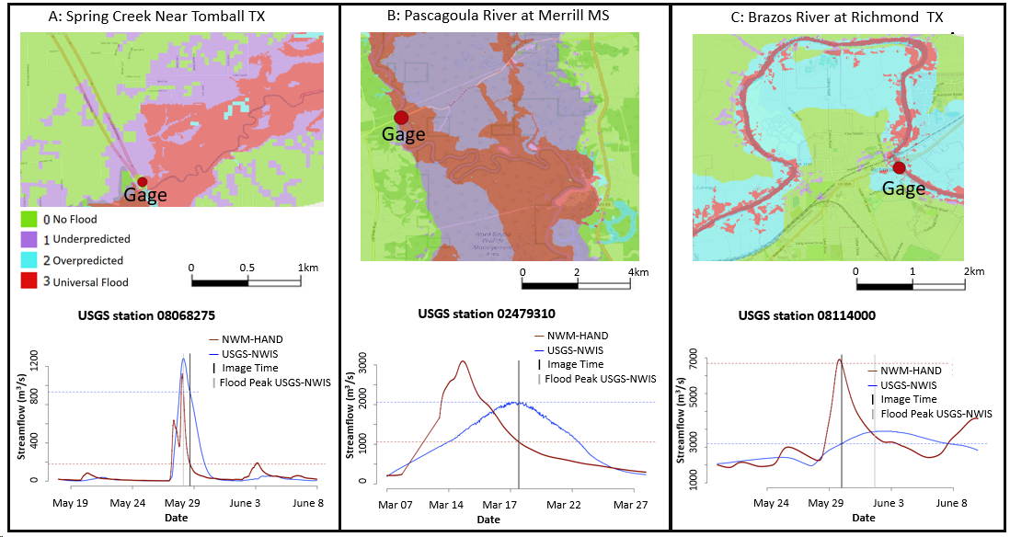
NWM-HAND Operational Flood Mapping
Johnson, Muskinghe, Eyelade, Cohen (2019: submitted): Comprehensive Evaluation of the National Water Model (NWM) - Height Above Nearest Drainage (HAND) Flood Mapping Methodology. NHESS

Slide 31
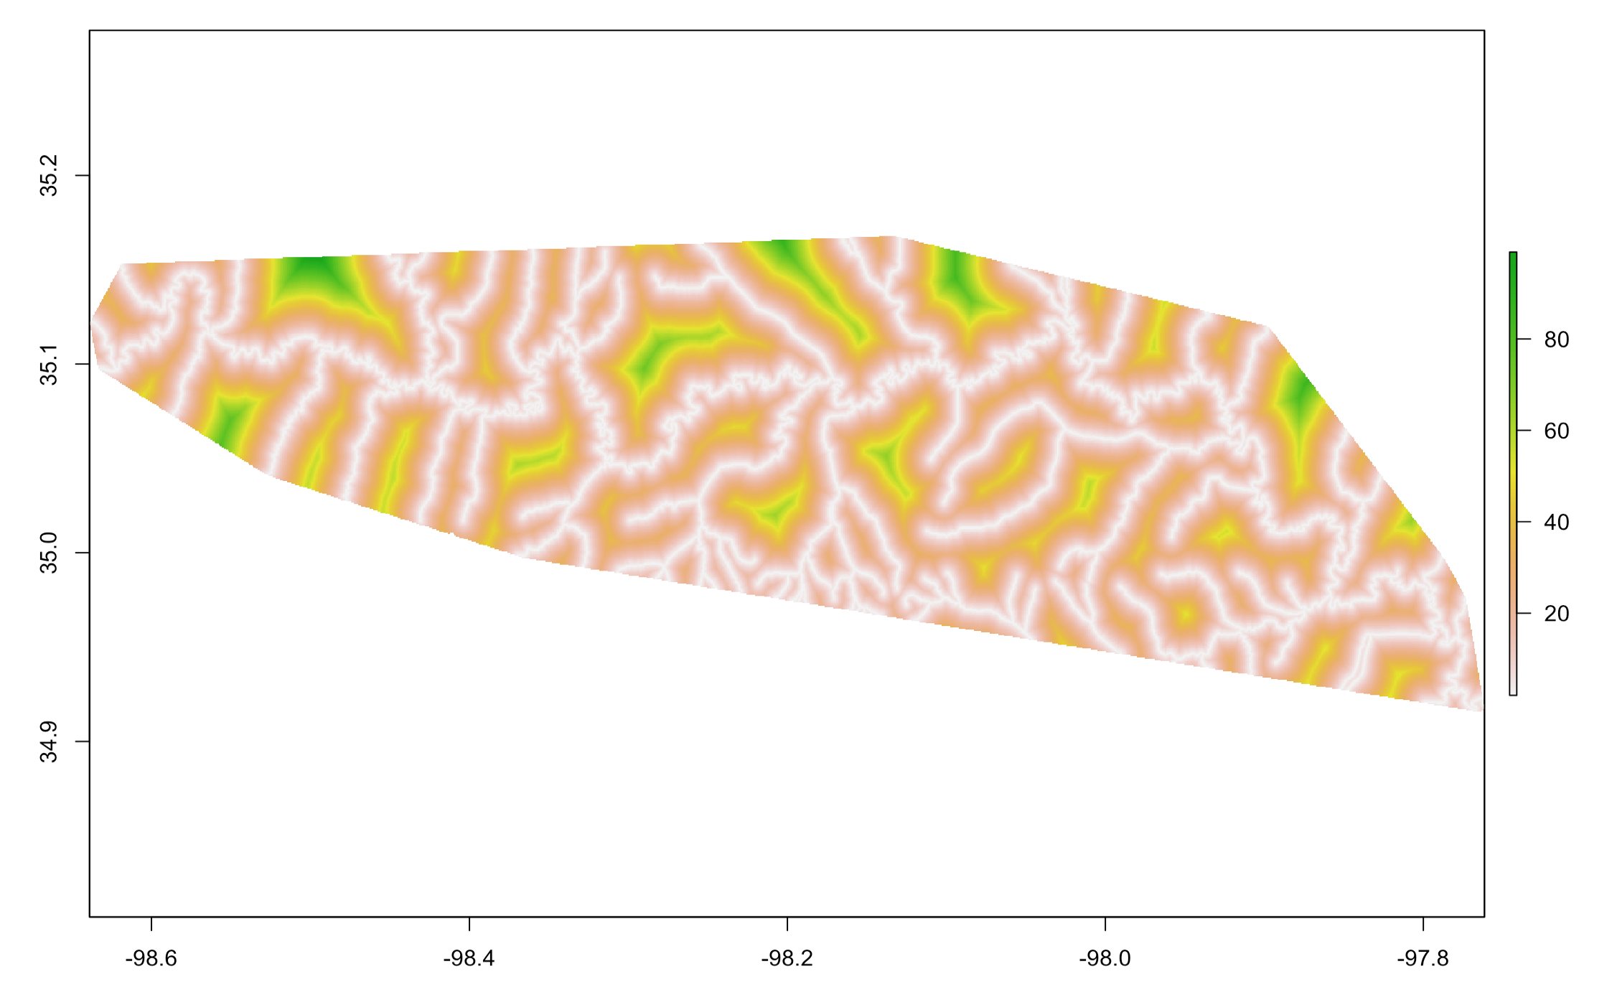
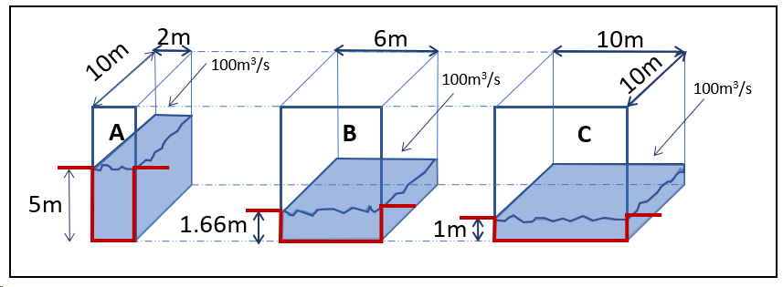
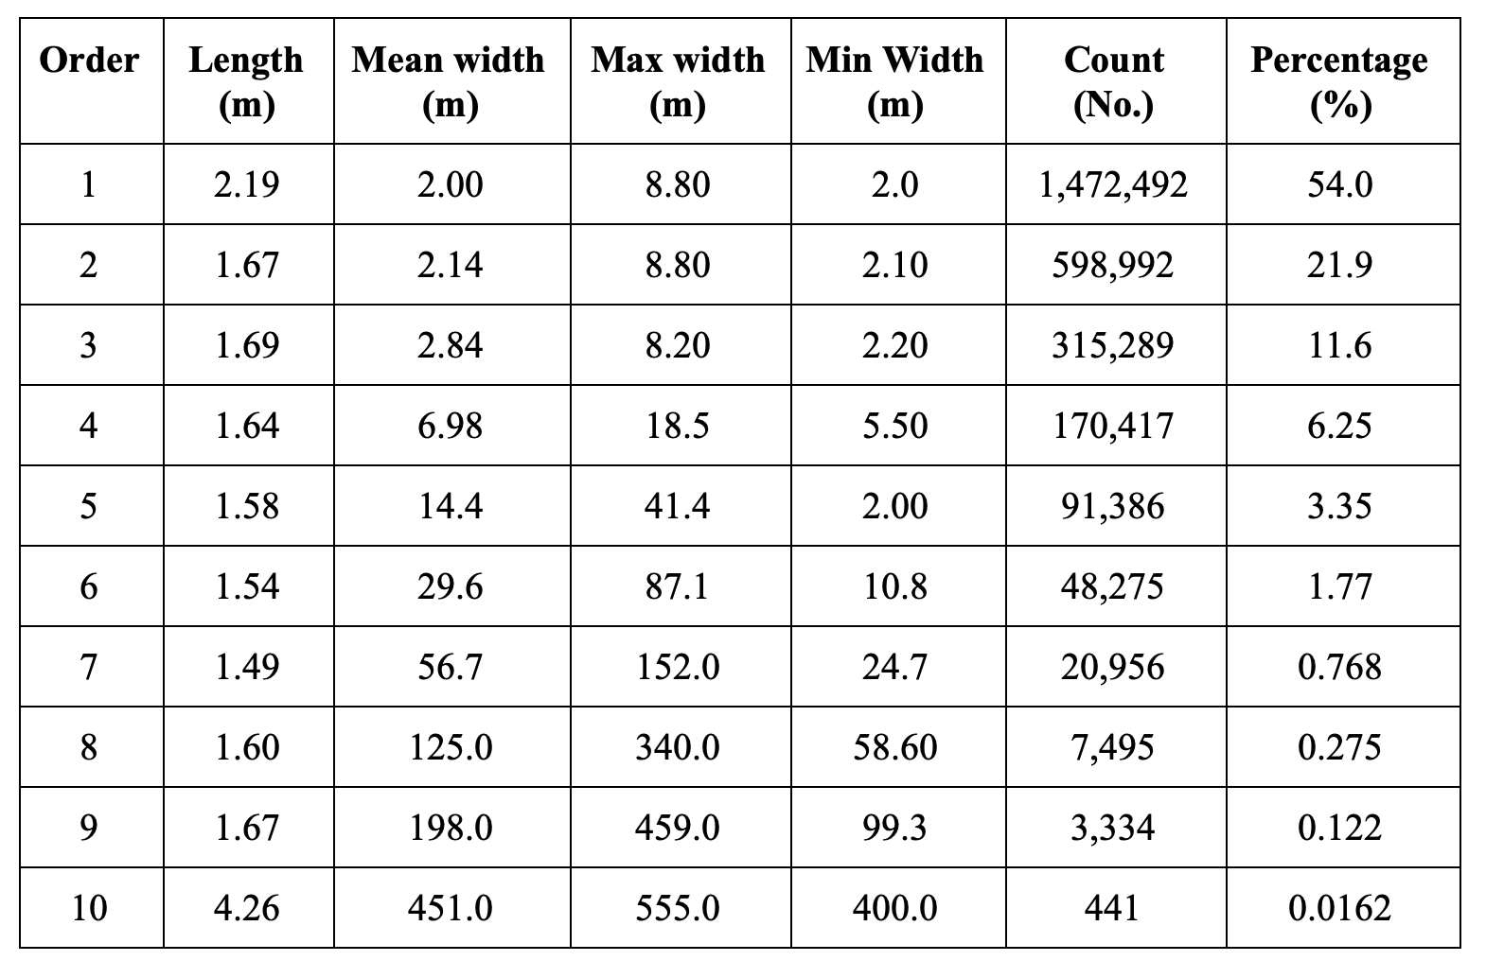
Improveing NWM-HAND forecasts using volume control and reach scalars

Slide 32
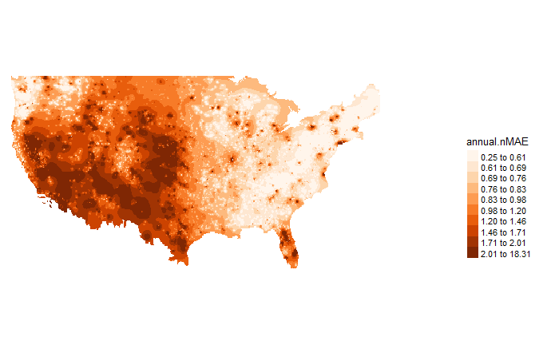
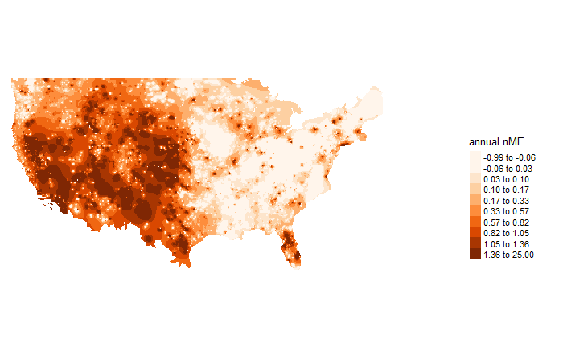
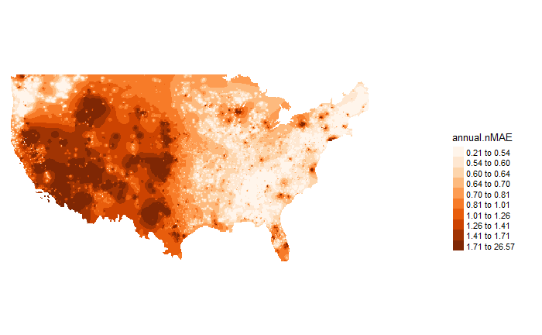
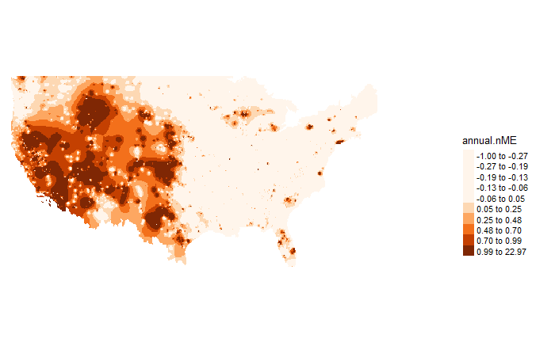
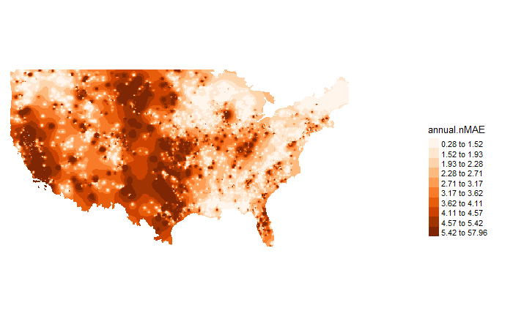
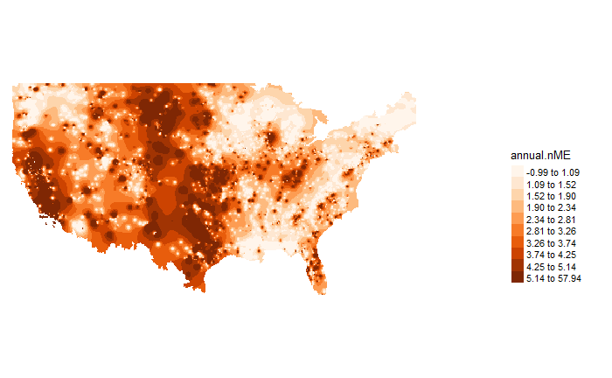
Normalize Mean Average Error
Normalize Mean Error
ALL
HIGH
LOW
Johnson, Chen: Comprehensive Evaluation of National Water Model Streamflow

Slide 33
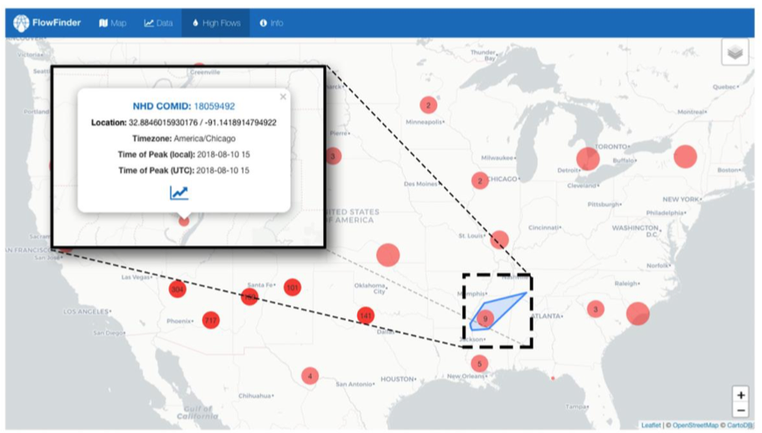
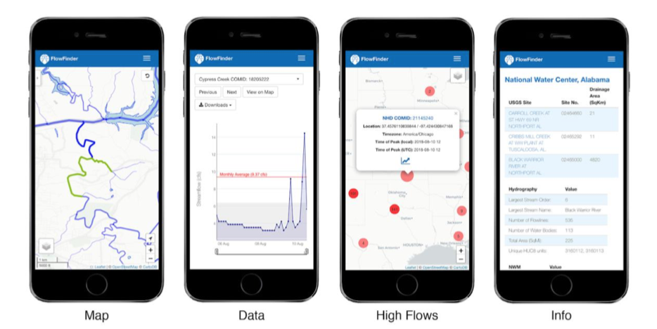
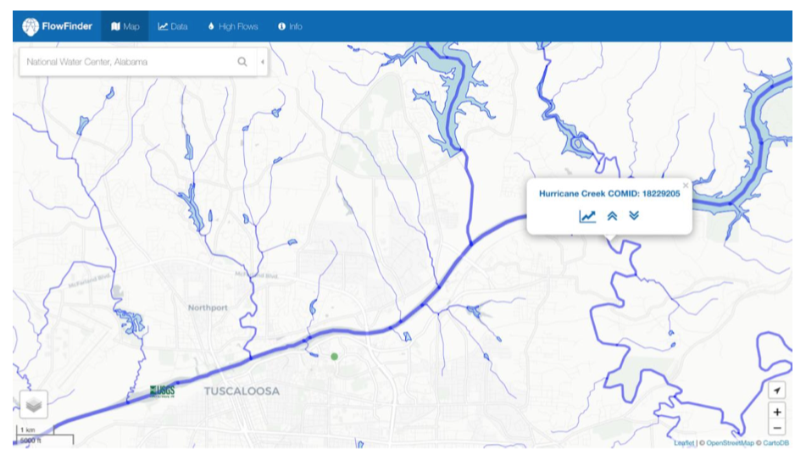
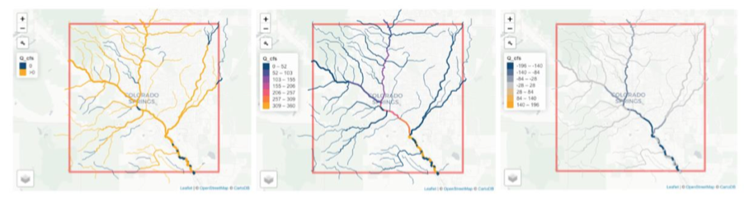
Flowline Finder
Johnson & Johnson Clarke: A National Scale Streamflow Visualization system

Slide 34
Chapter 7: California 2100??

Slide 35
Chapter 7: California 2100 ?
SUPPLY

